Slide 1
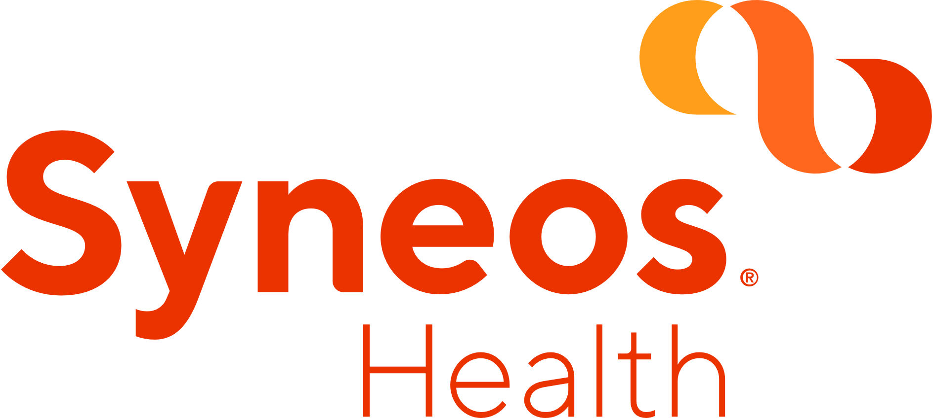
Syneos Health Global Training Project

Slide 2
Key Selling Points
Stable leadership structure
Great team culture
No micromanagement
Accessible leadership
Open dialogue and collaboration encouraged at and between all levels
Exposure to multiple sponsors and therapeutic areas
Opportunity to work on high profile studies and lead teams
Career/Organizational growth opportunity
Organic growth through department
Existing employees with appropriate interest and experience given priority for new management level openings.
Bi-weekly lunch and learns
Unlimited Vacation
Competitive Compensation Package (Rewards Program for Top Performers)

Slide 3
Open Positions- CRA (All TA Areas)
Sr. CRA II
7+ years experience
Sr. CRA I
5 - 6 years experience
CRA II
2 -3 years experience
Must have
monitoring experience

Slide 4
Open Positions- Senior/Clinical Operations Leads
Sr./ Clinical Operations Leads
Huge Opportunity to Gain Management exposure where they can manage 3 to 4 CRAs
They will also be observed during this time by the onboarding manager on their work style/ethic and their personality to place them with a line manager who best fits their needs (this is a really good selling point)
Open on TA area
Questions asked by candidates:
Will they be trained on what they are lacking (global/line management)?
YES
When will they get line management experience?
Not for 60-90 days
Does this position travel?
Minimal (bid defenses, trusted process meetings, co-monitoring, team meetings)
What is the career path?
(*Good selling point*) after COL there is a Sr. COL, and then sponsor or non-sponsor facing leadership roles, and we also have a resourcing team that has a lot of great opportunities.
Titles to target- Clinical Trial Manager, Clinical Research Manager, Clinical Study Manager, Clinical Team Manager, Clinical Trial Lead
https://www.linkedin.com/in/jessica-aponte-2026073/
https://www.linkedin.com/in/sola-tairu-4250b515/

Slide 5

Open Positions- Project Manager
Sr. PM
7+ years experience
PM II
5 years experience
PM I
1 -3 years experience
Kacie Gardella | LinkedIn
Chad Michael Hunter, Ph.D., PMP, ACRP-PM | LinkedIn
Peter Probst | LinkedIn
Manages a project as a project manager overseeing interdisciplinary clinical research studies and ensures compliance with GCP, relevant SOP’s, and regulatory requirements.
Acts as a primary liaison between the Company and the Customer to ensure timely study launch, conduct, and closeout according to the Customer’s and the Company’s contractual agreement.
Lead project team to ensure quality, timelines and budget management.
Open on TA area

Slide 6
Key CRO Companies to Target
Covance (Lab. Corp.)
IQVIA
Parexel
PRA Health Sciences
PPD
Charles River
ICON
Wuxi AppTec
MedPace
List of Additional CRO Companies
List of Contract Research Organizations (CROs) | Chronic Bronchitis (nbscience.com)

Slide 7
Market Movers Why work for a large CRO?
Ability to work with Top 5 Pharma companies
CRO industry is exploding as more Pharma/Biotech are outsourcing clinical trials
Pharma is going back to Business as usual
Unique Job Landscape for Compensation- Sign Bonus will be offered on a case-by-case basis
Syneos is trying to address the overall workload by hiring soo many people- to help offset workload.
Open to TA area- but they can provide more exposure to candidates who want Oncology experience

Slide 8
Submittal Process
Obtain candidate interest/confirmation and resume
Send me their name, resume and e-mail
I will send out the docusign (privacy form) for them to fill out and get them into the system
Fill out agency cover sheet (we don’t need e-mail confirmation from the candidate)
Use my name and contact information on the agency cover sheet.

